Slide 1

Software Project Management
Planning, Risk, and Tools

Slide 2

Key Planning Activities in Software Project Management
Requirement Gathering and Analysis
Understanding what the client or end-user needs from the software.
Defining Scope and Objectives
Clearly outlining what will and won’t be included in the project.
Creating a Work Breakdown Structure (WBS)
Breaking the project into smaller, manageable tasks or components.

Slide 3

Key Planning Activities in Software Project Management
4. Estimating Time and Cost
Predicting how long tasks will take and how much they will cost.
5. Resource Allocation
Assigning team members, tools, and technologies to specific tasks.
6. Scheduling
Developing a timeline using tools like Gantt charts or Agile sprints.
7. Risk Planning
Identifying potential risks and preparing mitigation strategies.

Slide 4

Key Planning Activities in Software Project Management
8. Communication Planning
Establishing how information will be shared among stakeholders.
9. Quality Planning
Setting standards and procedures to ensure the final product meets expectations.
10.Change Management Planning
Preparing for how changes in scope or requirements will be handled.

Slide 5

Importance of planning in software projects
Defines Clear Objectives
Planning helps establish what the project aims to achieve, aligning the team and stakeholders on goals and deliverables.
Improves Resource Management
It ensures optimal use of time, budget, and human resources, reducing waste and over-allocation.
Reduces Uncertainty and Risk
A well-thought-out plan anticipates potential issues and outlines strategies to mitigate them.

Slide 6

Importance of planning in software projects
Enhances Communication
Planning provides a roadmap that facilitates better communication among team members, clients, and stakeholders.
Enables Progress Tracking
With milestones and schedules in place, it becomes easier to monitor progress and make adjustments as needed.
Supports Decision-Making
A solid plan provides the data and structure needed to make informed decisions throughout the project lifecycle.

Slide 7
What is a Project?
Project Defined
  A complex, nonroutine, one-time effort limited by time, budget, resources, and performance specifications designed to meet customer needs.
Major Characteristics of a Project
  Has an established objective.
  Has a defined life span with a beginning and an end.
  Requires across-the-organizational participation.
  Involves doing something never been done before.
  Has specific time, cost, and performance requirements.

Slide 8
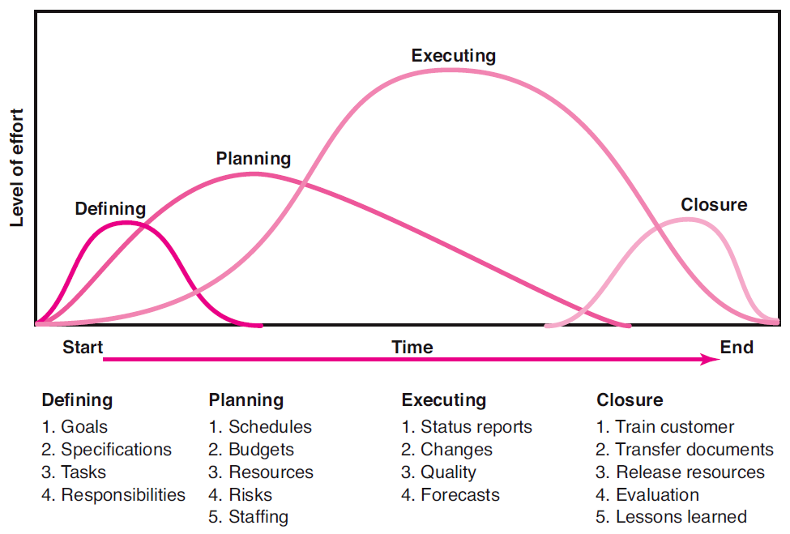
Project Life Cycle
FIGURE 1.1

Slide 9
Defining the Project
Step 1: Defining the Project Scope
Step 2: Establishing Project Priorities
Step 3: Creating the Work Breakdown Structure
Step 4: Integrating the WBS with the Organization
Step 5: Coding the WBS for the Information System

Slide 10

Project Scope Checklist
Project objective
Deliverables
Milestones
Technical requirements
Limits and exclusions
Reviews with customer

Slide 11

Project Scope: Terms and Definitions
Scope Statements
  Also called statements of work (SOW)
Project Charter
  Can contain an expanded version of scope statement
  A document authorizing the project manager to initiate and lead the project.
Scope Creep
  The tendency for the project scope to expand over time due to changing requirements, specifications, and priorities.

Slide 12
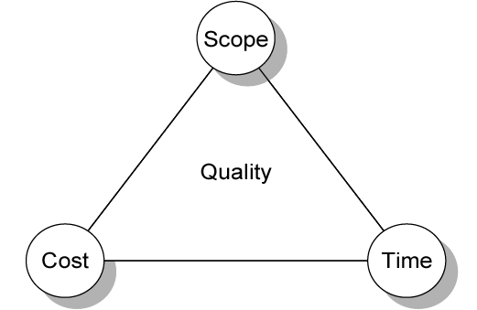
Project Management Trade-offs
FIGURE 4.1

Slide 13
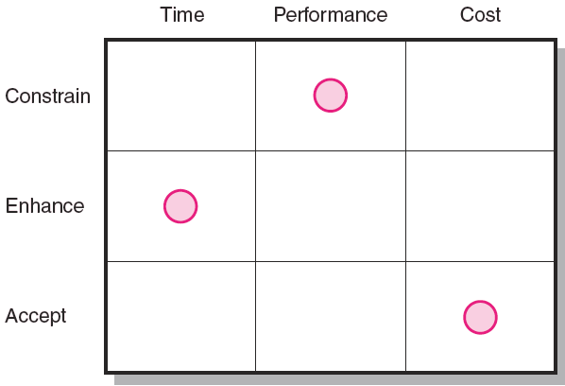
Project Priority Matrix
FIGURE 4.2

Slide 14
Project Scope and Objectives
S Specific Be specific in targeting an objective
M Measurable Establish a measurable indicator(s) of progress
A Assignable Make the objective assignable to one person
for completion
R Realistic State what can realistically be done with
available resources
T Time related State when the objective can be achieved,
that is, duration
EXHIBIT 2.1

Slide 15

Work Breakdown Structure (WBS)
Work Breakdown Structure (WBS)
  An hierarchical outline (map) that identifies the products and work elements involved in a project.
  Defines the relationship of the final deliverable
  (the project) to its subdeliverables, and in turn,
  their relationships to work packages.
  Best suited for design and build projects that have tangible outcomes rather than process-oriented projects.

Slide 16
Creating the Work Breakdown Structure
Work Breakdown Structure (WBS)
  A hierarchical outline (map) that identifies the products and work elements involved in a project.
  Defines the relationship of the final deliverable
  (the project) to its subdeliverables, and in turn,
  their relationships to work packages.
  Best suited for design and build projects that have tangible outcomes rather than process-oriented projects.

Slide 17
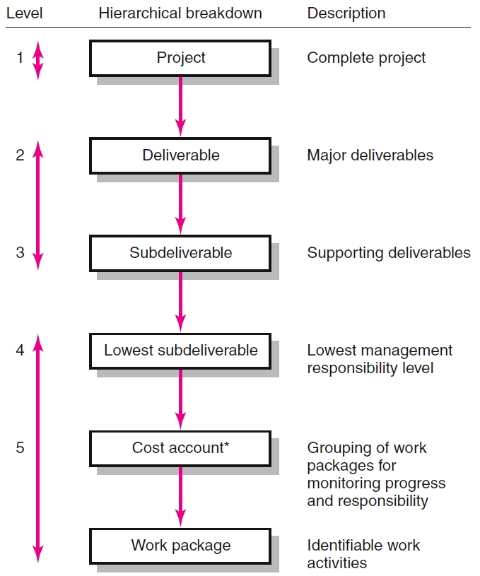
Hierarchical Breakdown of the WBS
* This breakdown groups work packages by type of work within a deliverable and allows assignment of responsibility to an organizational unit. This extra step facilitates a system for monitoring project progress (discussed in Chapter 13).
FIGURE 4.3

Slide 18

How WBS Helps the Project Manager
WBS
  Facilitates evaluation of cost, time, and technical performance of the organization on a project.
  Provides management with information appropriate
  to each organizational level.
  Helps in the development of the organization breakdown structure (OBS). which assigns project responsibilities to organizational units and individuals
  Helps manage plan, schedule, and budget.
  Defines communication channels and assists
  in coordinating the various project elements.

Slide 19
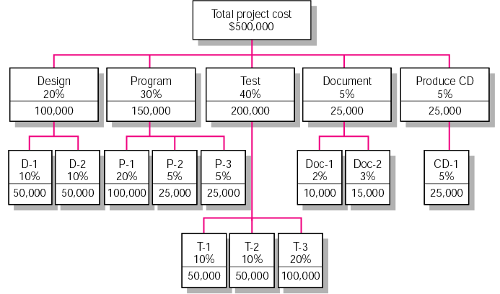
Example Work Breakdown Structure
FIGURE 5.1

Slide 20
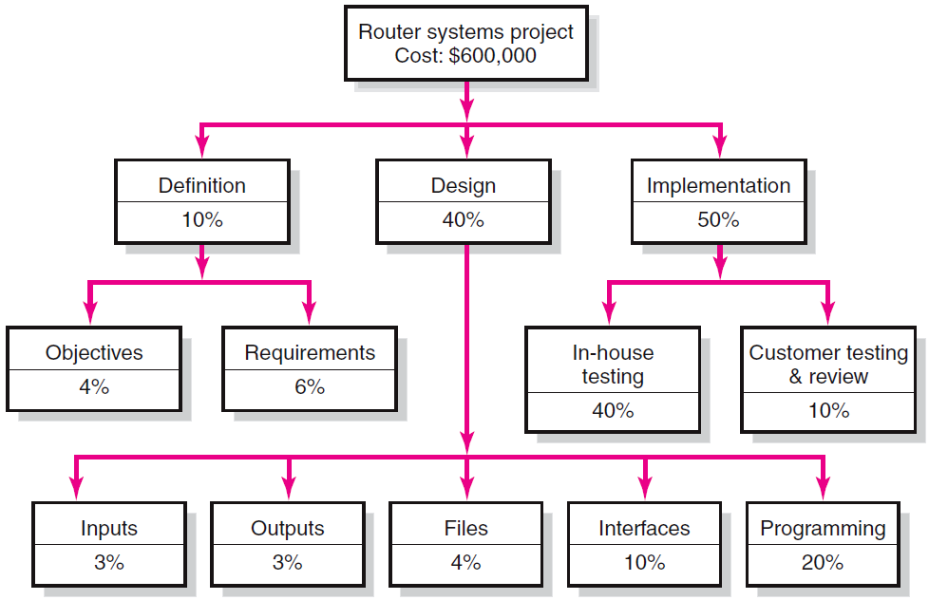
WBS Figure
TABLE 5.4

Slide 21

Scheduling Techniques
Gantt charts
• Milestones and deliverables

Slide 22
Critical Path Method (CPM)
The Critical Path Method is a project management technique used to determine the longest sequence of dependent tasks and the shortest possible project duration. It helps identify tasks that directly impact the project timeline.
Float (also called Slack) is the amount of time a task can be delayed without affecting:
The start of subsequent tasks (free float).
The project completion date (total float).

Slide 23

Developing the Project Plan
The Project Network
  A flow chart that graphically depicts the sequence, interdependencies, and start and finish times of the project job plan of activities that is the critical path through the network.
    Provides the basis for scheduling labor and equipment.
    Enhances communication among project participants.
    Provides an estimate of the project’s duration.
    Provides a basis for budgeting cash flow.
    Identifies activities that are critical.
    Highlights activities that are “critical” and can not be delayed.
    Help managers get and stay on plan.

Slide 24
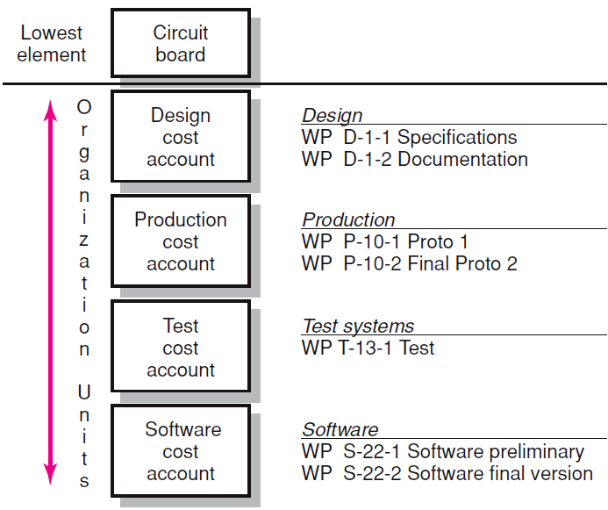
WBS/Work Packages to Network

Slide 25
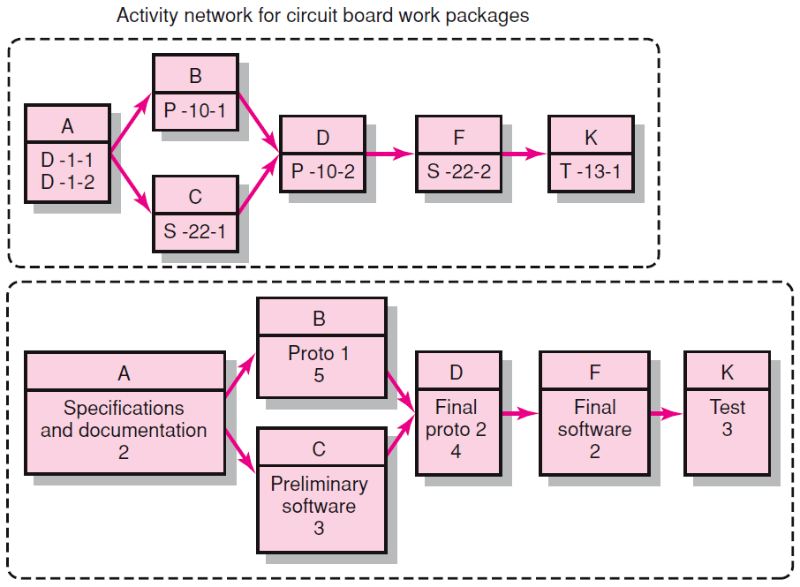
WBS/Work Package to Network (cont’d)
FIGURE 6.1 (cont’d)

Slide 26
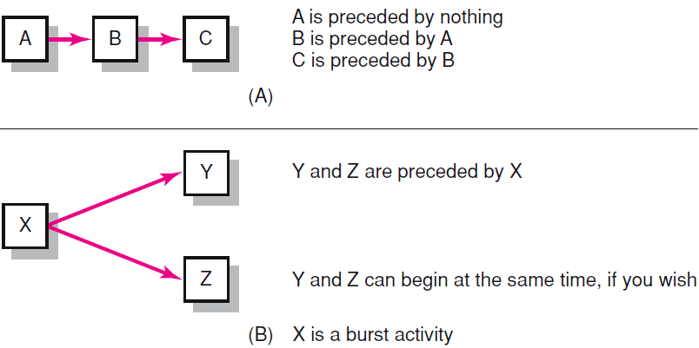
Activity-on-Node Fundamentals
FIGURE 6.2

Slide 27
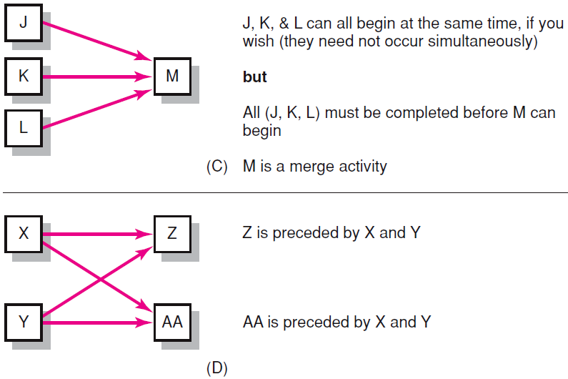
Activity-on-Node Fundamentals (cont’d)
FIGURE 6.2 (cont’d)

Slide 28
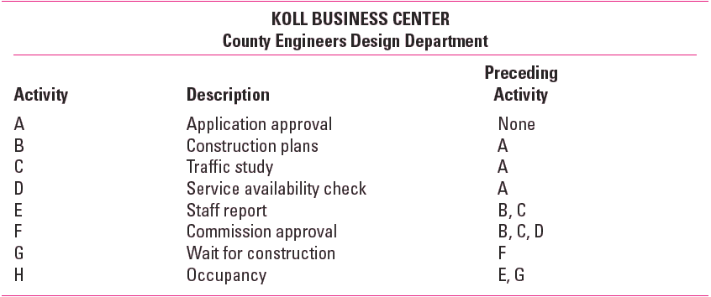
Network Information
TABLE 6.1

Slide 29
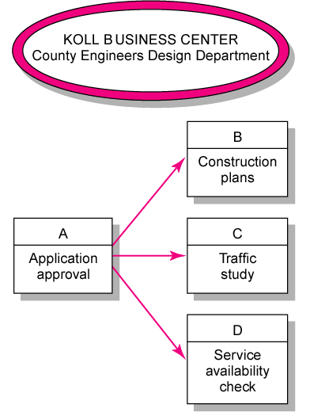
Koll Business Center—Partial Network
FIGURE 6.3

Slide 30
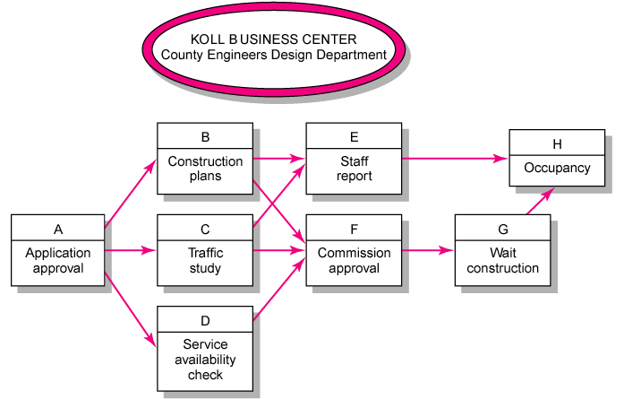
Koll Business Center—Complete Network
FIGURE 6.4

Slide 31
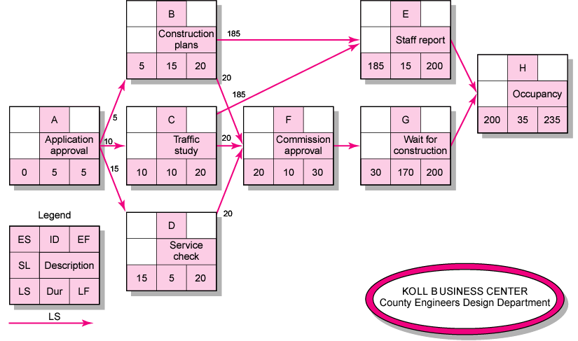
Activity-on-Node Network Backward Pass
FIGURE 6.7

Slide 32
Risk Management Process
Risk
Uncertain or chance events that planning can not overcome or control.
Risk Management
A proactive attempt to recognize and manage internal events and external threats that affect the likelihood of a project’s success.
What can go wrong (risk event).
How to minimize the risk event’s impact (consequences).
What can be done before an event occurs (anticipation).
What to do when an event occurs (contingency plans).

Slide 33
Risk Management’s Benefits
A proactive rather than reactive approach.
Reduces surprises and negative consequences.
Prepares the project manager to take advantage
of appropriate risks.
Provides better control over the future.
Improves chances of reaching project performance objectives within budget and on time.

Slide 34
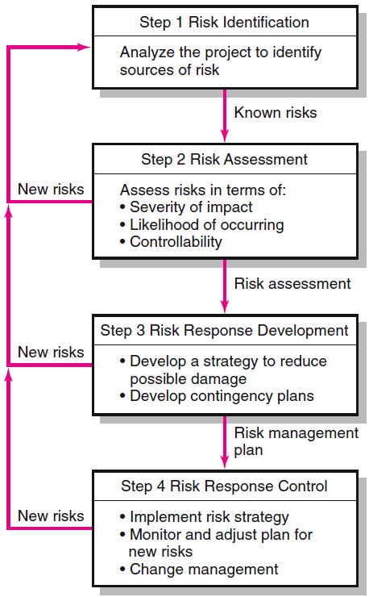
The Risk Management Process
FIGURE 7.2

Slide 35
Types of Risks: Technical Risks
Related to the technology used in the project.
Examples:
Unfamiliar tools or platforms
Integration issues
Performance bottlenecks

Slide 36
Project Management Risks
Arise from poor planning or execution.
Examples:
Inaccurate time/cost estimates
Scope creep
Resource misallocation

Slide 37
Organizational Risks
Stem from internal company issues.
Examples:
Staff turnover
Lack of stakeholder support
Conflicting priorities

Slide 38
External Risks
Originate outside the organization.
Examples:
  Regulatory changes
  Market shifts
  Vendor delays

Slide 39
Operational Risks
Affect day-to-day functioning.
Examples:
  Infrastructure failures
  Security breaches
  Data loss

Slide 40
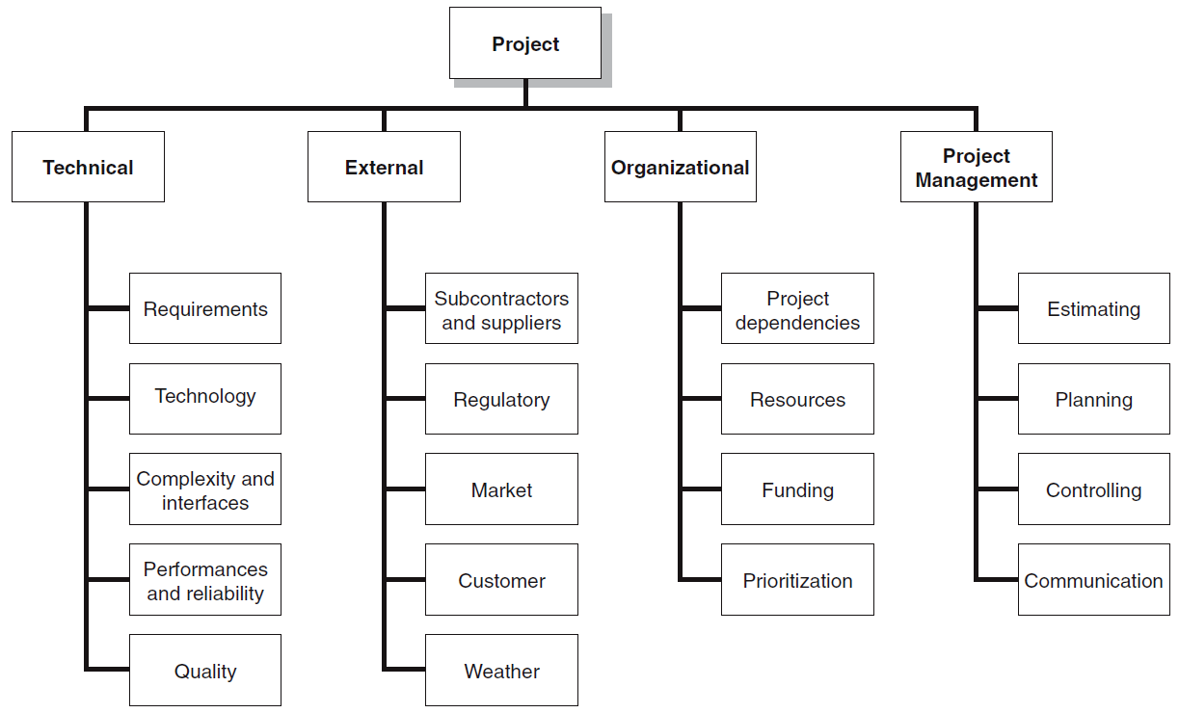
The Risk Breakdown Structure (RBS)
FIGURE 7.3

Slide 41
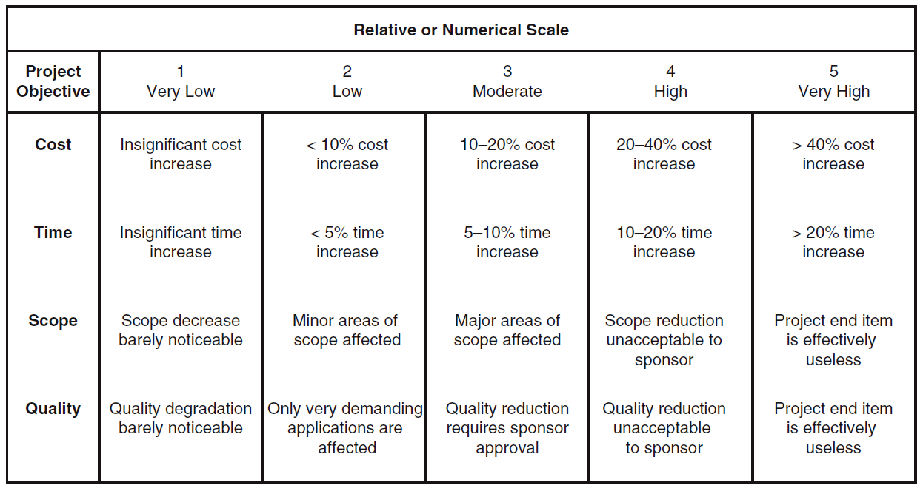
Defined Conditions for Impact Scales of a Risk on Major Project Objectives (Examples for negative impacts only)
FIGURE 7.5

Slide 42
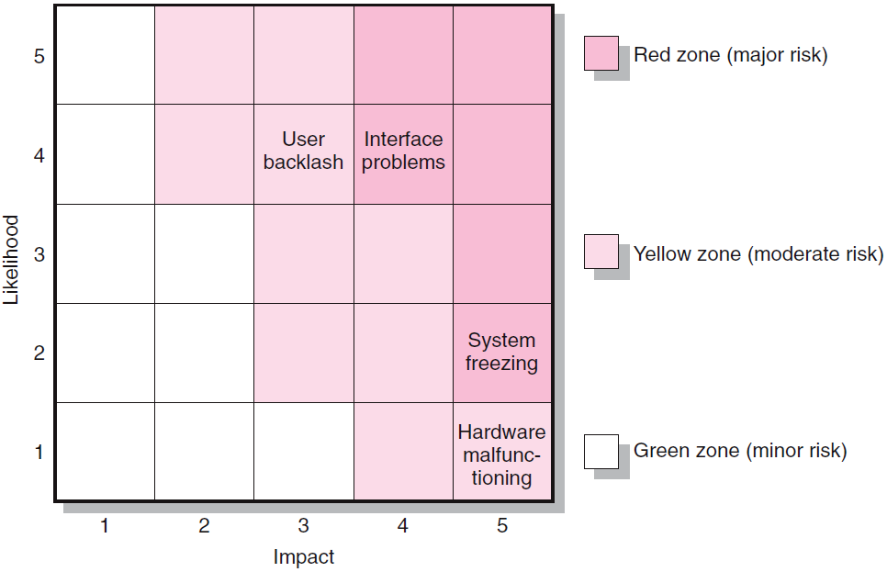
Risk Severity Matrix
Failure Mode and Effects Analysis (FMEA)
Impact × Probability × Detection = Risk Value
FIGURE 7.7

Slide 43
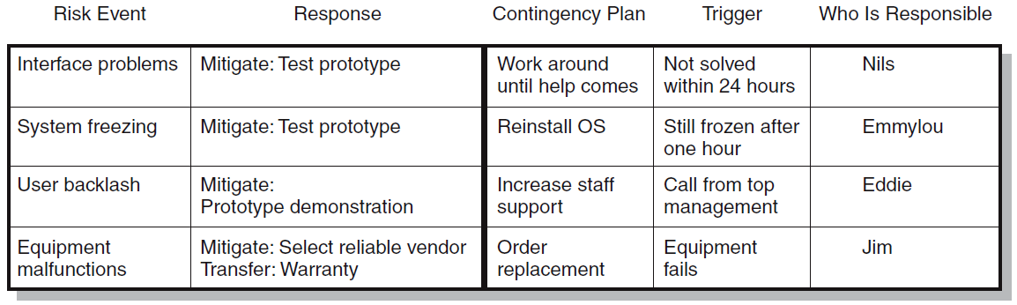
Risk Response Matrix
FIGURE 7.8

Slide 44
Risk Mitigation and Contingency
Avoidance
  • Reduction
  • Transfer
  • Acceptance

Slide 45
Project Planning Tools
Microsoft Project
  • GanttProject

Slide 46
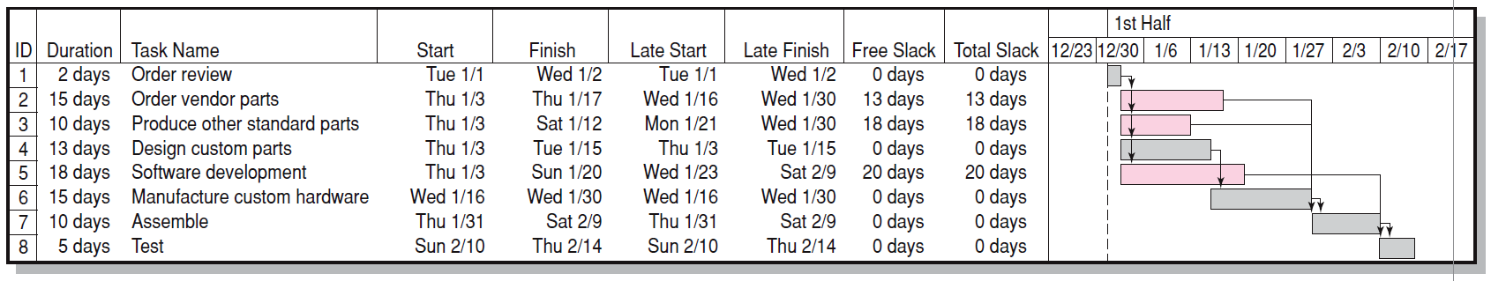
Air Control Project—Gantt Chart
FIGURE 6.12

Slide 47
Agile Project Management Tools - Jira
Jira is a powerful project management tool developed by Atlassian, widely used for Agile software development and issue tracking.
  Scrum and Kanban Boards: Visualize workflows and manage sprints.
  Backlog Management: Prioritize and plan upcoming work.
  Custom Workflows: Tailor processes to match team needs.
  Issue Tracking: Log, assign, and monitor bugs or tasks.
  Reports and Dashboards: Burndown charts, velocity reports, etc.
  Integration: Works with Confluence, Bitbucket, GitHub, and CI/CD tools.

Slide 48

Agile Project Management Tools - Trello
Trello is a visual project management tool that uses a card-based Kanban system. It’s known for its simplicity and flexibility.
  Boards, Lists, and Cards: Organize tasks visually.
  Drag-and-Drop Interface: Easy to update task status.
  Labels and Checklists: Add context and subtasks.
  Due Dates and Reminders: Keep track of deadlines.
  Power-Ups: Add features like calendar view, integrations, and automation.
  Collaboration Tools: Commenting, attachments, and mentions.

Slide 49
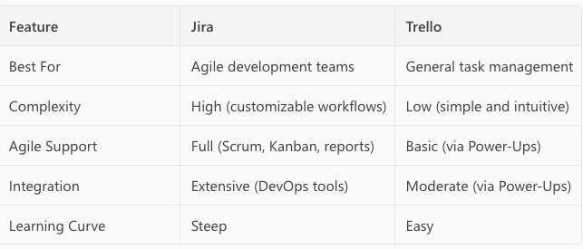
Comparison

Slide 50
Choosing the Right Tool
Factors to consider
• Integration
• Scalability

